Slide 1
CCCC Tool Demo
Shubham Gupta 22MCA0179
Ankit Kumar 22MCA
Rajat Singh 22MCA0139
Sambit Basu 22MCA0240
Srijan Paria 22MCA0266

Slide 2
Contents
Why Software Metrics?
Tool Description
Features of CCCC
Project Summary and Procedural Metrics Summary
Object Oriented Design
Structural Metrics Summary
Output(Demo Screenshots)
Conclusion

Slide 3
Why Software Metrics?
Code Quality Assessment
Code Maintainability
Performance Optimization
Project Estimation
Team Performance Monitoring
Decision Making and Risk Assessment
Benchmarking and Best Practices

Slide 4
Tool Description
Full form is C and C++ Code Counter tool, also known as a source code metrics tool or code counting tool
A software utility used to analyze the size and complexity of C and C++ programs.
Helps software developers and project managers to understand various aspects of their codebase, such as the number of lines of code, comments, function counts, and other relevant metrics.

Slide 5
Features of CCCC
Project Summary and Procedural Metrics Summary
Object Oriented Design
Structural Metrics Summary

Slide 6
Project Summary and Procedural Metrics Summary
NOM (Number of modules): Non-trivial modules include all classes, and any other module for which member functions are identified.
LOC (Lines of Code): Number of non-blank, non-comment lines of source code counted by the analyzer.
COM (Lines of Comments): Number of lines of comment identified by the analyser
MVG (McCabe's Cyclomatic Complexity): It is the number of linearly independent routes through a directed acyclic graph which maps the flow of control of a subprogram.
L_C (Lines of code per line of comment): Indicates density of comments with respect to textual size of program
M_C (Cyclomatic Complexity per line of comment): Indicates density of comments with respect to logical complexity of program
IF4 (Information Flow measure): It measures the flow of information or data between different components, modules, or functions within the system.

Slide 7
Object Oriented Design
WMC (Weighted methods per class): The sum of a weighting function over the functions of the module.
DIT (Depth of inheritance tree): The length of the longest path of inheritance ending at the current module. Increasing depth gives the potential of greater reuse by the current module of behavior defined for ancestor classes.
NOC (Number of children): The number of modules which inherit directly from the current module. Moderate values of this measure indicate scope for reuse, however high values may indicate an inappropriate abstraction in the design.
CBO (Coupling between objects): The number of other modules which are coupled to the current module either as a client or a supplier. Excessive coupling indicates weakness of module encapsulation and may inhibit reuse.

Slide 8
Structural Metrics Summary
FI (Fan-in): The number of other modules which pass information into the current module.
FO (Fan-out): The number of other modules into which the current module passes information
IF4 (Information Flow measure): It measures the flow of information or data between different components, modules, or functions within the system.

Slide 9
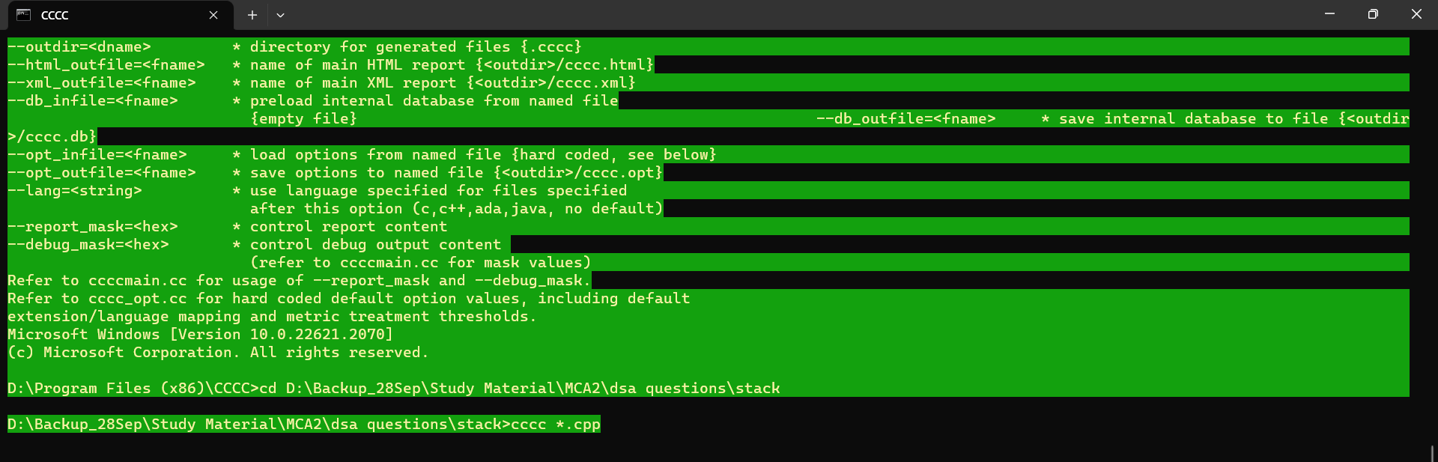
Starting Terminal View of CCCC

Slide 10
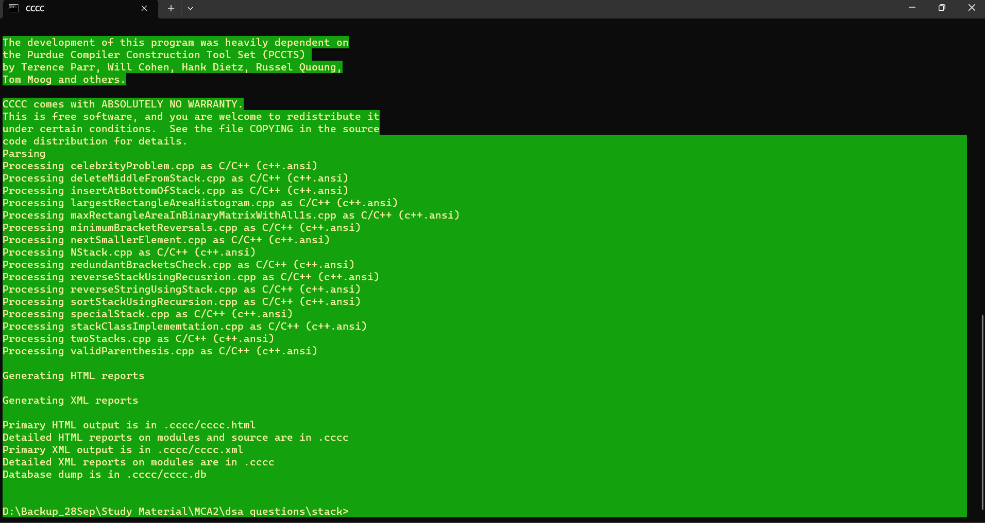
Output View(Terminal)

Slide 11
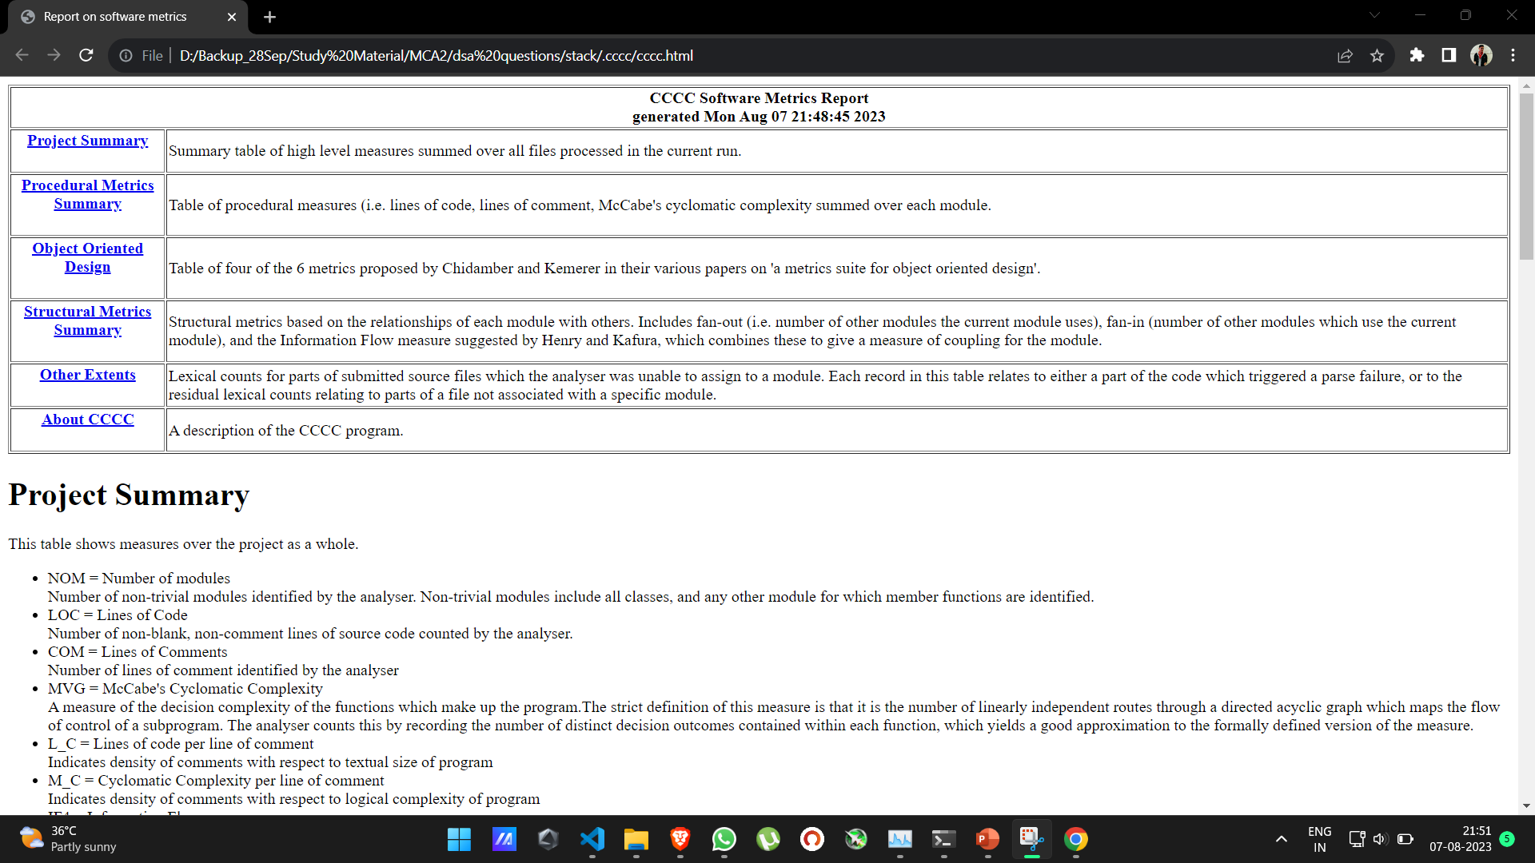
Output View (HTML page)(1/4)

Slide 12
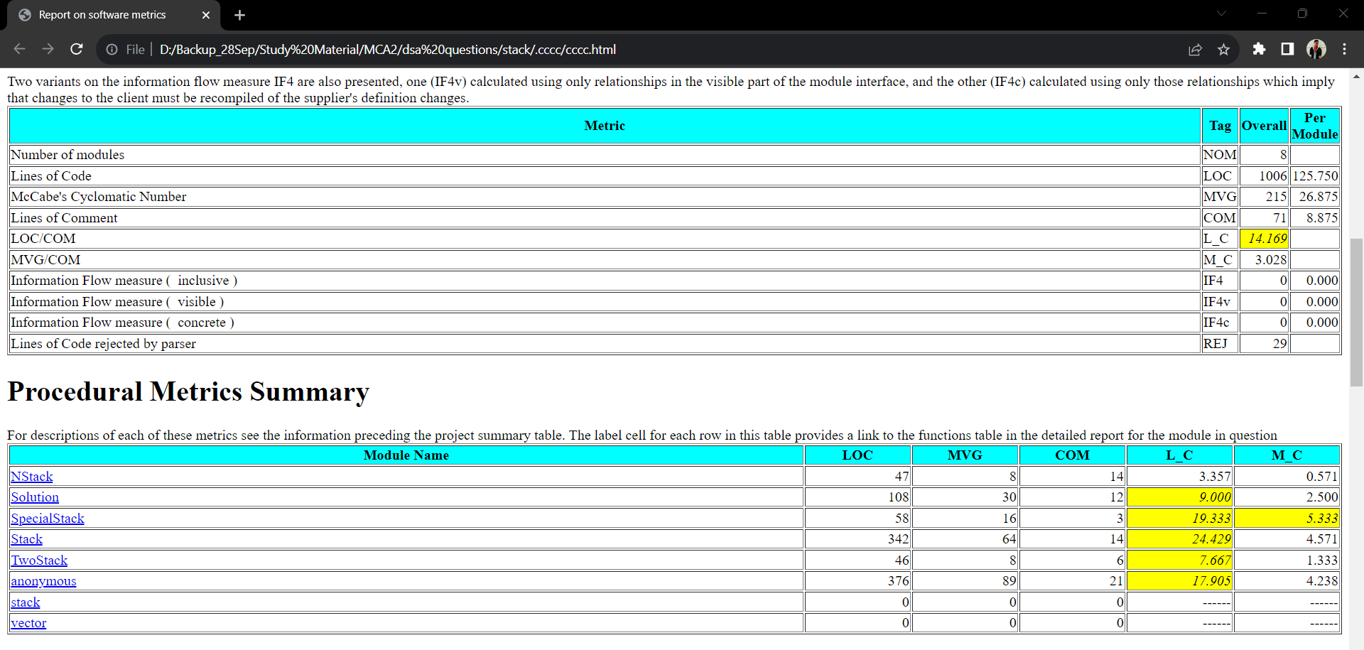
Output View (HTML page) (2/4)

Slide 13
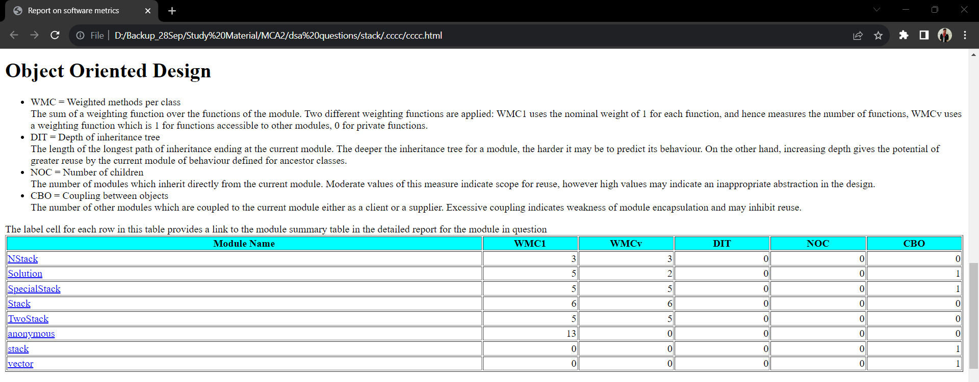
Output View (HTML page) (3/4)

Slide 14
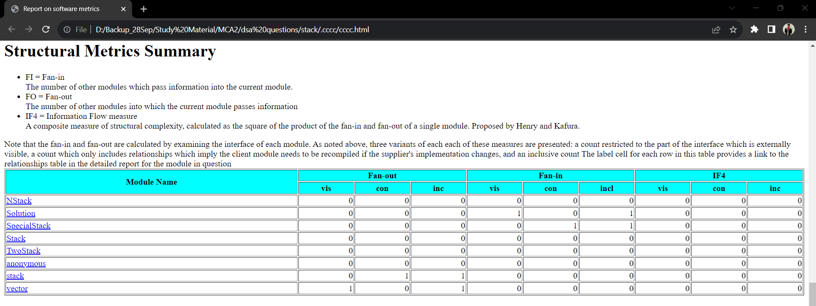
Output View (HTML page) (4/4)

Slide 15
Conclusion
In conclusion, the CCCC software metrics tool offers a powerful and user-friendly solution for code analysis. With its comprehensive insights into code quality, maintainability, and performance, developers can make informed decisions to enhance software development processes effectively.

Slide 16
Thank You

